Slide 1
Value of generic medicines

Slide 2



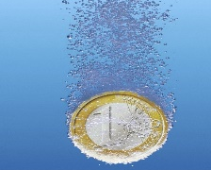

Medicines for Europe Vision 2020
Our 5 pillars
PATIENTS
QUALITY
Medicines For Europe VISION
VALUE
SUSTAINABILITY
PARTNERSHIP
Notes:
Patients: We create enhanced access to medicines, reducing inequalities, directly leading to improved patient outcomes. We compete, stimulating the medicines industry to innovate. We innovate, enriching patient benefit.
Quality: We provide a stable and resilient supply of high-quality medicines, manufactured and developed according to stringent EU regulatory requirements, for Europe’s patients and healthcare providers.
Value: Our high-quality cost-effective medicines account for well over 56% of all prescription medicines used to treat European patients. We are the heart of public health delivery in Europe. By deceasing health inequalities in Europe, our industry delivers great value to improved health outcomes.
Sustainability: Use of our medicines supports the economic sustainability of Europe’s healthcare systems. We contribute to Europe’s economies, researching, developing and manufacturing in most European countries the majority of medicines used in the EU, sustaining more than 160.000 high skilled, high value direct jobs. As a leading knowledge based industry we will continue to work with Europe’s policy makers, legislators and regulators to create the right environment to support and strengthen the economic sustainability of our industry so that we can continue to contribute to European patients and society
Partnership: We build constructive partnerships, focused on a strong and stable collaboration with patients and patient organisations, the EU institutions, governments and regulators, healthcare professionals and others to further enhance public health in Europe.

Slide 3
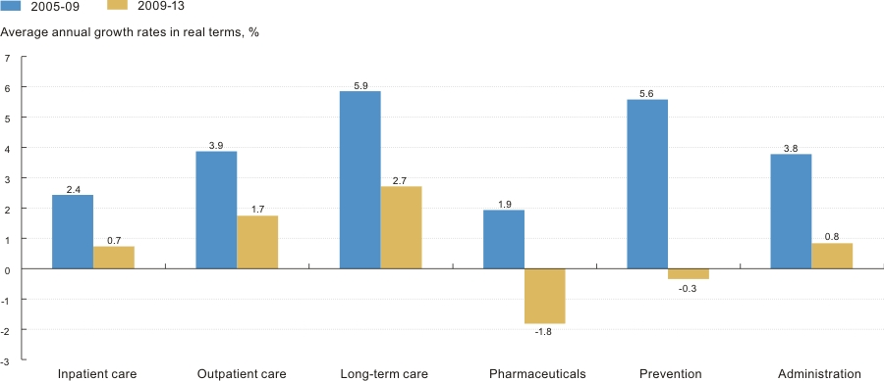
Pressure on EU budgets
Reduction of healthcare spending
Growth rates of health spending for selected functions per capita, OECD average, 2005-2013
Source: OECD Health at a Glance (2015)
Notes:
Due to the financial and economic crisis, many European Member States have introduced a plethora of austerity measures to balance national budgets, with some particular focus on healthcare spending. OECD data from 2015 shows that average annual growth rates of health spending per capita, in the different fields of health care (inpatient care, outpatient care, long-term care, pharmaceuticals, prevention and administration), have all dropped since 2009. Out of all these fields, we can see that pharmaceuticals have been a key target for government when looking for savings, with even a negative growth of almost 2% over the last 4 years as shown by OECD data.

Slide 4
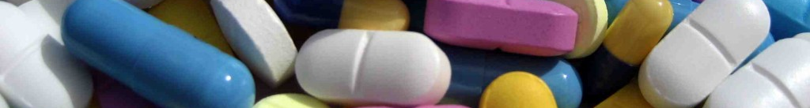
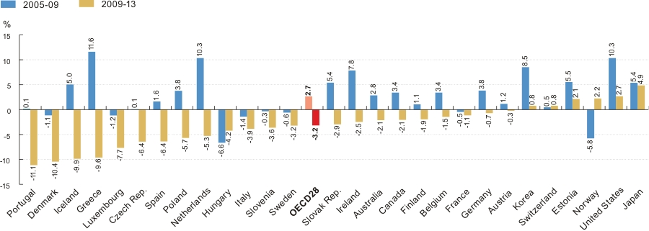
Reduction of healthcare spending
Focus on pharmaceuticals
Average annual growth in pharmaceutical expenditure¹ per capita, in real terms, 2005-09 and 2009-13 (or nearest periods)
¹ Includes medical non-durables.
Source: OECD Health at a Glance (2015)
Notes:
In addition, further OECD data demonstrate that those countries which have seen the most negative growth in pharmaceutical spending include the ones that have been the most heavily affected by the financial crisis – Portugal, Greece, Spain and Italy.

Slide 5
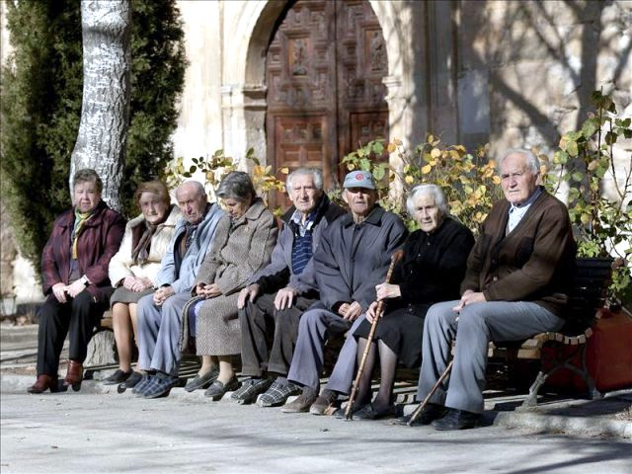

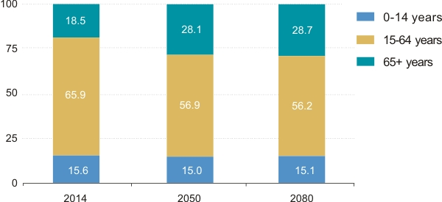

An ageing population:
Major EU social and economic challenge
Modern lifestyle and an ageing population increase prevalence of chronic disease
129 Million patients
Population Structure by Major Age Groups
EU28, 2014-2080 (percentage of total population)
2014
+50%
Population
over 65 years
191 Million patients
2050
Source: Eurostat Population Statistics
Notes:
In addition to the aftermath of the financial and economic crisis and reduction in healthcare and pharmaceutical spending, Europe is faced with an ageing European population (slide 5). In 2014, the population over 65 years was 129 million, which will increase to 191million in 2050, representing a 50% increase in this age group. This means that around 28% of the entire population will be aged over 65 years by 2050, which is undoubtedly associated with an increase in the prevalence of chronic diseases.

Slide 6
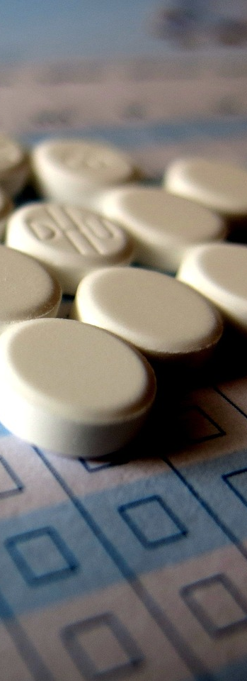
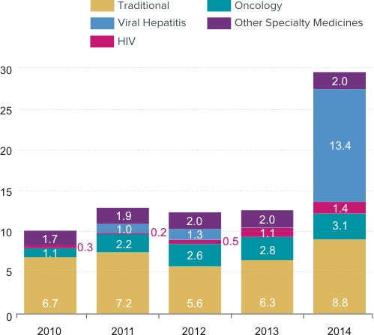
A surge in innovation:
Major EU social and economic challenge
Global spending on new brand medicines has more than doubled in 2014 and is 2.6% of global
pharmaceutical spending
Global New Brand Spending Growth USD Bn
USD
Source: IMS Health, R&D Focus, May 2015; MIDAS, Q4 2014, constant USD
Notes:
The growth in the elderly population is also accompanied by another challenge – the high prices of new branded medicines coming to the market. IMS data shows that global spending on new brand medicines has more than doubled in 2014 to almost 29 BN USD, which constitutes about 2.6% of total global pharmaceutical spending in 2014. These numbers also clearly highlight the impact of viral hepatitis drugs on this figure. Both of Europe’s ageing population and the increased cost of new branded medicines pose a major social and economic challenge for Europe and open up the debate of healthcare sustainability.

Slide 7
Generic medicines are key to EU healthcare sustainability
Increased access to medicines
Reduction of health inequalities
Better health outcomes
VALUE OF GENERIC MEDICINES
Positive Economic impact
Improved medication adherence
Notes:
It is clear that generic medicines provide a positive economic impact within Europe (slide 8).

Slide 8
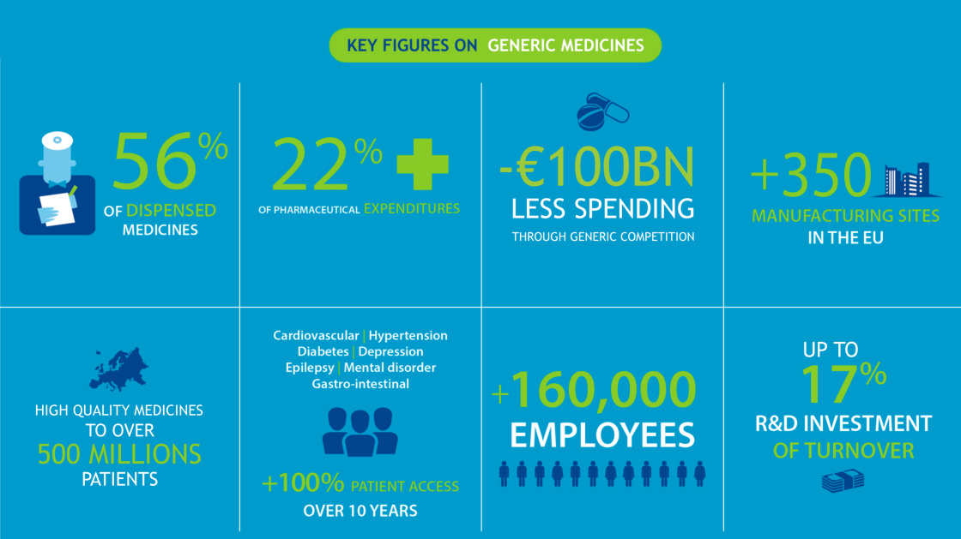
Generic Medicines
A Cornerstone of Healthcare Sustainability
Notes:
This is where generic medicines come into play. Generic medicines offer an incredible opportunity for the sustainability of European healthcare systems. Generic medicines make up 56% of dispensed medicines within Europe, while only accounting for 22% of pharmaceutical expenditure. Patient access to high quality medicines has more than doubled over the past ten years thanks to generic medicines and without generic competition, European governments would have had to pay an additional 100 BN EUR in 2014.
Generic medicines are not only crucial for healthcare systems but are also an important contributor to the European economy. Over 350 manufacturing sites across Europe produce Europe’s essential medicines, employ over 160,000 employees and invest 7-17% of their turnover into R&D activities.
R&D investment originator companies: range from 7-25%. Within Europe, the pharmaceutical industry spends above 30bn euros on R&D, which ranks them second only behind the automotive industry. However, relative to their turnover, the pharmaceutical industry is the biggest investor in R&D.

Slide 9
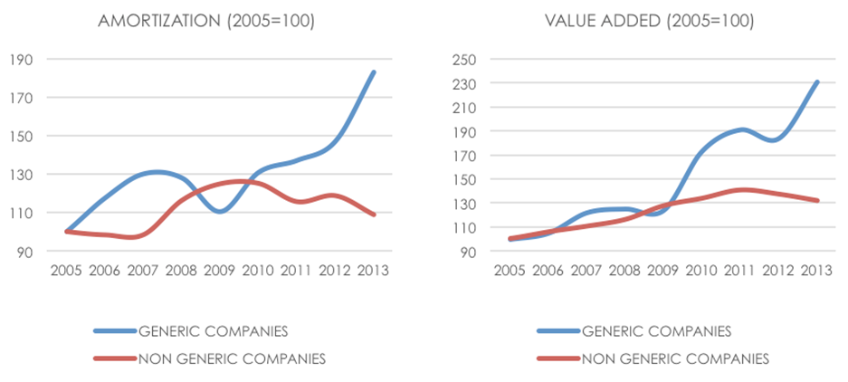
Contribution to overall economy
Generic medicines industry
Activation of investments, employment and value added
Depreciation and value added trends – 2005-2013 (Italy)
Source: Nomisma (2015) – The generic medicines system in Italy: Scenarios for sustainable growth
Notes:
The generic medicines system has had equally significant effects within the manufacturing base. In Italy for instance, in the past five years, generic medicines companies have made a relatively greater contribution to growth in investment, value added and employment than the pharmaceutical sector as a whole, showing that the potential positive impact could go well beyond the simple effect of public spending rationalization.

Slide 10
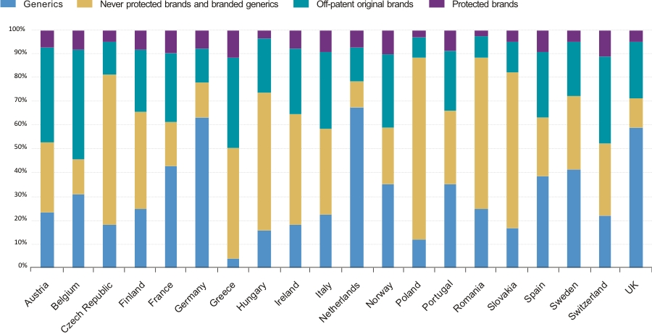
Still considerable opportunities to increase uptake throughout Europe
Protected and off-patent marked share (volume) by country, June 2015
Source: IMS Health, MIDAS, Q2 2015, retail and hospital channel
Note: Non-original brands and branded generics include copy products in some countries; Generics include INN branded and company branded
Notes:
While generic medicines already contribute to the sustainability of healthcare budgets, the value that they bring to Europe can still be expanded. In many European national markets, there is still a considerable amount of off-patent original brands available for generic production and penetration into markets, both by volume and value. The green sections of the bar graphs in this slide demonstrate this opportunity in volume across different markets in Europe.

Slide 11
Generic medicines are key to EU healthcare sustainability
Increased access to medicines
Reduction of health inequalities
Better health outcomes
VALUE OF GENERIC MEDICINES
Positive Economic impact
Improved medication adherence
Notes:
However, while the debate on generic medicines has been centred on affordability and cost savings so far, their overall value is more comprehensive which can be shown at multiple levels. Much more important is the fact that generic medicines increase access to high quality treatment and as such reduce health inequalities in Europe.

Slide 12

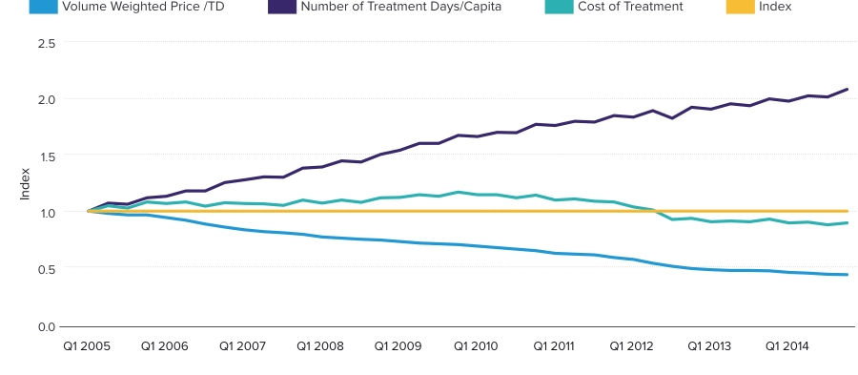
Generic medicines increase patient access
Twice as many patients treated… without an impact on treatment costs
Evolution of volume, price and treatment cost in seven therapy areas
Selected therapy areas: Hypertension, epilepsy, gastro-intestinal disorders, mental health, high cholesterol and diabetes.
Source: IMS Institute for Healthcare Informatics. The Role of Generic Medicines in Sustaining Healthcare Systems. June 2015.
Notes:
IMS has calculated that between 2005 and 2015, across seven disease areas, twice as many patients have been treated without any impact on treatment costs. This shows the crucial role generic medicines play in increasing access to medicines for patients in need.

Slide 13
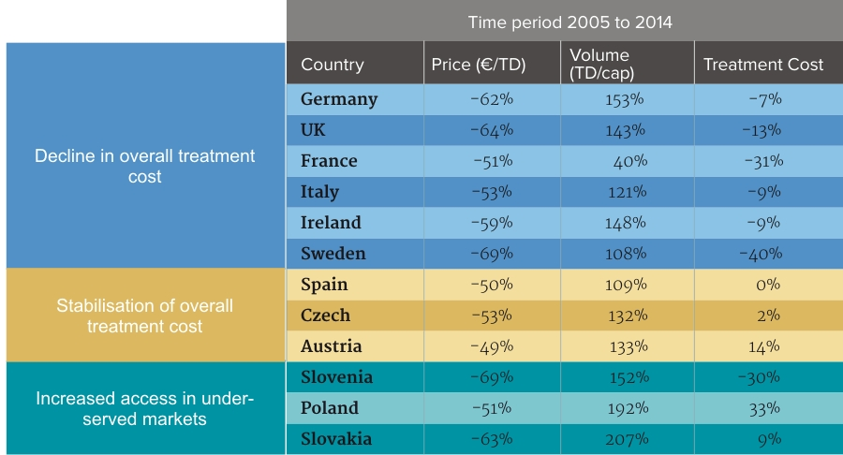
Benefits accrue in different ways across countries
Increased access to medicines delivers long-term benefits to society and to healthcare providers
Increased access in under-
served groups
Source: IMS Health, MIDAS, Q4 2014; OECD Population statistics
Selected therapy areas: angiotensin II antagonists, anti-epileptics, anti-psychotics, anti-ulcerants, cholesterol regulators and oral anti-diabetics.
Notes:
However these benefits manifest themselves differently across Europe. The countries in the blue rows already experienced a good level of access to the medicine before patent expiry. Entrance of generic medicines in these countries led to a decline in overall treatment cost. On the other side of the spectrum, we have countries in the green rows which experienced limited access to the medicine before patent expiry. In these countries, generic competition considerably increased patient access. Generic medicines therefore reduce healthcare inequalities by increasing patient access in underserved markets.

Slide 14
Generic medicines reduce healthcare inequalities
Cost-efficiency gains | Investment in health
Reduce healthcare expenditure without compromising health outcomes | Improve health outcomes through better patient access without increasing health expenditure
Source: Kaló,Z et al. (2014). Investment aspects of generic drug policies in countries with severe resource constraints.
Poster presented at ISPOR Annual European Congress in Amsterdam
Notes:
Therefore, it is important that governments realize that the entrance of generic medicines does not necessarily lead to cost-efficiency gains but that they should also be regarded as an investment in health in certain cases, as patient access is improved for the same expenditure.

Slide 15
Generic medicines are key to EU healthcare sustainability
Increased access to medicines
Reduction of health inequalities
Better health outcomes
VALUE OF GENERIC MEDICINES
Positive Economic impact
Improved medication adherence
Notes:
Additionally, generic medicines have a major role to play in improving adherence.

Slide 16
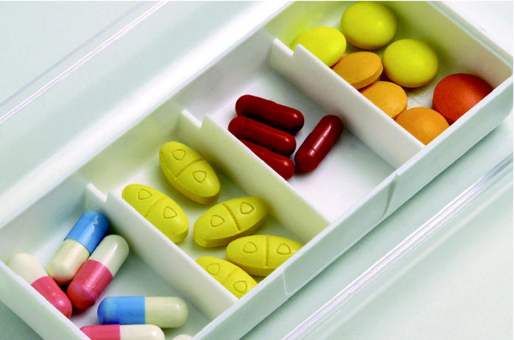
Better adherence will improve health outcomes and lead to a positive economic impact
Lack of adherence is estimated to cost the European governments €125 billion / year
Avoidable cost for the National Healthcare System
Avoidable cost
for NHS (in %)
Additional cost of poor adherence compared to the total
healthcare expenditure
Source: New England Healthcare Institute: A system-wide approach to improving patient medication adherence for chronic disease (2009)
Note: €125bn/year is an A.T. Kearney estimate based on US avoidable cost data
Notes:
This is especially important since a lack of adherence can lead to inefficiencies within healthcare systems such as increased physician visits, emergency department visits, long-term care facility admissions, hospital admissions and additional prescriptions. In total, it was estimated that the avoidable cost to healthcare systems due to lack of adherence is around 14% of the total healthcare expenditure, which is equal to around 125 billion EUR per year cost to European governments.

Slide 17
Better adherence will improve health outcomes and lead to a positive economic impact
Appropriate generic medicine policies can improve adherence
Generic medicines positively influence adherence in systems with lower co-payment for generic medicines
The pharmacist’s role in ensuring patient understanding and comfort with medication through accurate information and dialogue is crucial to maximize adherence when substituting
Adherence is linked to patient co-payment*
Italian patients receiving generic amlodipine, with lower patient co-payment, were more adherent compared to branded amlodipine**
Impact of substitution
Adherence of Dutch patients, which have one designated pharmacy, was not influenced by substituting generic hypertensive medicines for a branded medicine**
*Co-payment exists across Europe, including but not restricted to the following countries: Belgium, Bulgaria, Finland, Hungary, Ireland, Italy (regional), Portugal, Romania, Switzerland. (Source: EGA market review 2015)
**Source: IGES Study, Value of Generic Medicines, 2015
Notes:
So how can generic medicines improve adherence?
First of all, it is well-known that adherence is linked to co-payments. In Italy, for instance, it was observed that patients receiving generic amlodipine, with lower patient co-payment, were more adherent compared to branded amlodipine. This shows that generic medicines positively influence adherence in systems with lower patient co-payment for generic medicines.
However, it is also well-known that generic substitution might negatively influence adherence. Generic substitution can generate confusion for patients, especially the elderly, as they may differ substantially in their appearance. Patients thus may receive medicines from a different company every time their prescription is refilled This confusion could lead to medication errors or decreased medication adherence.
In the Netherlands however, it was observed that adherence of Dutch patients, which have one designated pharmacy, was not influenced by substituting generic hypertensive medicines from a branded medicine. This example shows the important role pharmacists have to play and that patient education & information is crucial to prevent potential negative effects of generic substitution on adherence. Overall, we can conclude that generic medicines can improve adherence, which will ultimately lead to considerable cost-efficiency gains for health systems.

Slide 18
Generic medicines are key to EU healthcare sustainability
Increased access to medicines
Reduction of health inequalities
Better health outcomes
VALUE OF GENERIC MEDICINES
Positive Economic impact
Improved medication adherence
Notes:
Finally, generic medicines can lead to better health outcomes. A recent study by IGES shows the impact of generic medicines on health outcomes for three different disease states – hypertension, breast cancer and depression.

Slide 19

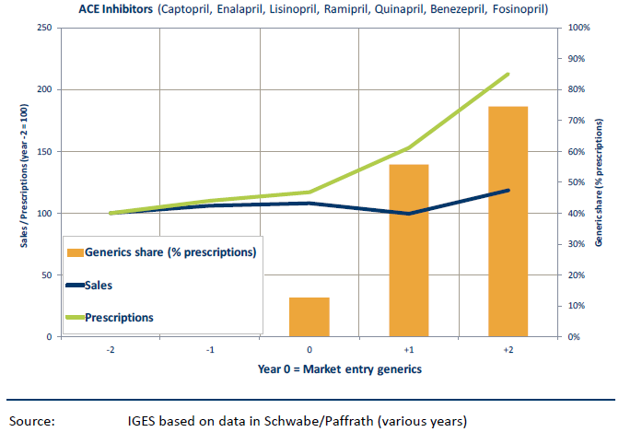
Better health outcomes - Hypertension
Antihypertensive drugs reduce mortality in hypertensive patients
50% decrease in hypertension related mortality in DE (1998-2010)
  Increased access and treatment rates
  Better medicinal treatment options
  Smoking reduction
  Better hypertension control
  Guideline implementation
Change of generic market share and total prescriptions of anti-hypertensives (Germany)
Increased cost-effectiveness
Source: IGES Study, Value of Generic Medicines, 2015
Source: IGES based on data in Schwabe/Paffrath (various years)
Notes:
In hypertension patients, it is known that antihypertensive drugs reduce mortality. For instance, between 1998 and 2010, hypertension related mortality decreased by 50% in Germany. While this was due to a number of reasons including better treatment options, smoking reduction, better hypertension control or guideline implementation, increased access and treatment rates played a key role which is caused by the entry of generic medicines.
Through the graph, we observe that when generic ACE inhibitors entered the German market, there was a steep increase in the use of these medicines while treatment costs remained stable, which have overall led to better health outcomes as well as increased cost-effectiveness.

Slide 20

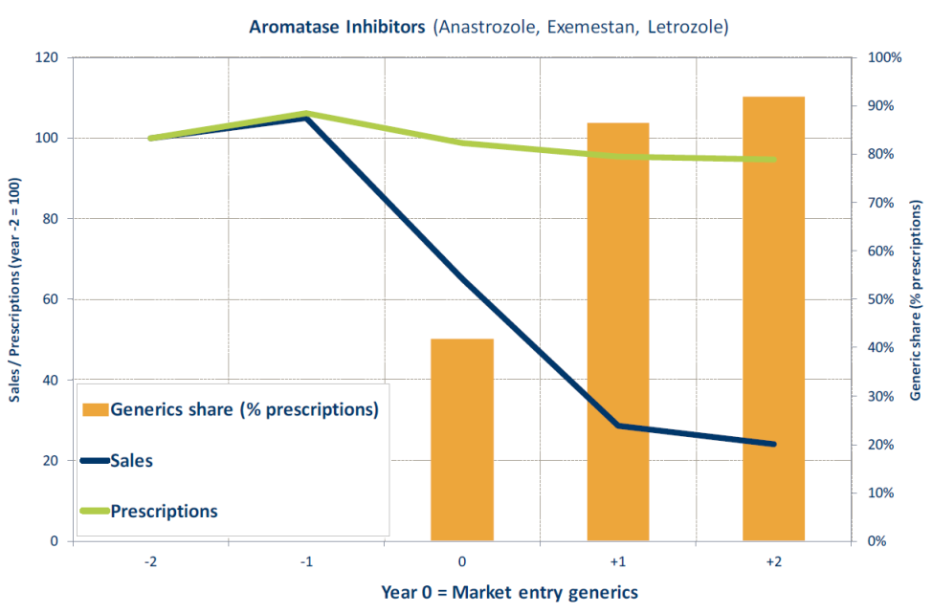
Better health outcomes - Breast cancer
Adjuvant endocrine therapies: Over 15 years after treatment start, mortality is reduced by 1/3 and recurrence rates by 40%
Breast cancer related mortality decreased since late 1980s
  Improved treatment options
  Increased access
  Early detection programs
Change of generic market share and total prescriptions of anti-hypertensives (Germany)
Decreased cost/QALY
Source: IGES Study, Value of Generic Medicines, 2015
Source: IGES based on data in Schwabe/Paffrath (various years)
Notes:
Generic medicines have also had a positive impact on health outcomes for breast cancer patients. It has been observed that over 15 years after the start of treatment with adjuvant endocrine therapies, mortality in breast cancer patients has been reduced by 1/3rd and recurrence rates by 40%.
Additionally, breast cancer related mortality has decreased since the late 1980s due to improved treatment options, increased access and early detection programs.
The graph clearly demonstrates that when generic aromatase inhibitors entered the German market, they allowed for the stable continued use of these medicines and considerably reduced treatment costs, finances which could then be invested in other treatments. Overall, generic medicines have led to better health outcomes as well as decreased costs/QALY.

Slide 21

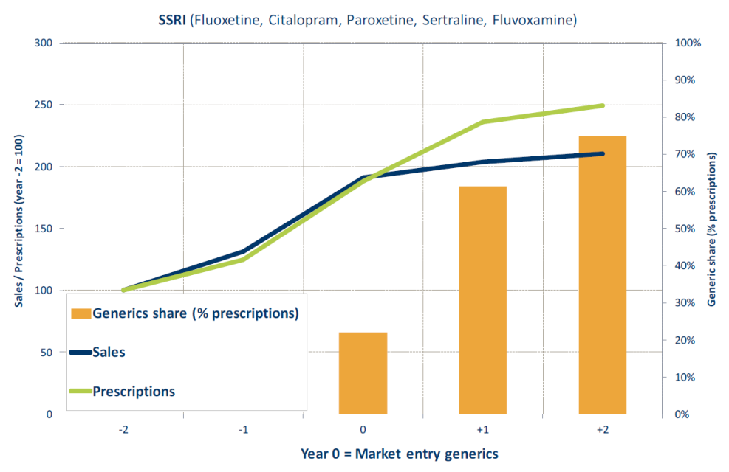
Better health outcomes - Depression
Anti-depressants: More effective than placebo in treatment of severe depression
45% of suicides attributable to depression
Mortality due to suicide decreased since 1980s
  Improved treatment options
  Improved psychotherapy
  Increased access
Change of generic market share and total prescriptions of anti-hypertensives (Germany)
Facilitated continued increase of low treatment rates
Source: IGES Study, Value of Generic Medicines, 2015
Source: IGES based on data in Schwabe/Paffrath (various years)
Notes:
Better health outcomes have also been observed in depression patients.
Although the evidence for the effectiveness of anti-depressants in depression patients is ambiguous, it is known that they are more effective than placebo in the treatment of major depression. 45% of suicides are attributable to depression and mortality due to suicide has decreased since the 1980s. This has been due to improved treatment options and improved psychotherapy. Before the entry of generic SSRIs into the German market, there was a continuous increase in the use of on-patent SSRIs, most likely due to better diagnosis and acceptance of the disease.
Once generic SSRIs entered the market, they led to a further increase in the use of SSRIs while dampening the costs. Therefore, generic SSRIs allowed for the facilitated continued increase of low treatment rates, helping meet unmet need and improve health outcomes.

Slide 22
Generic medicines are key to EU healthcare sustainability
Increased access to medicines
Reduction of health inequalities
Better health outcomes
VALUE OF GENERIC MEDICINES
Positive Economic impact
Improved medication adherence
Notes:
We can conclude that generic medicines bring considerable value to European healthcare systems at multiple levels. Besides leading to a positive economic impact by creating efficiency gains, employment and R&D investment, generic medicines
increase access to medicines,
reduce healthcare inequalities,
improve medication adherence and
generate better health outcomes.
The uptake and usage of generic medicines is therefore essential for the sustainability of European healthcare systems and the health of European patients.

Slide 23
Back-up

Slide 24
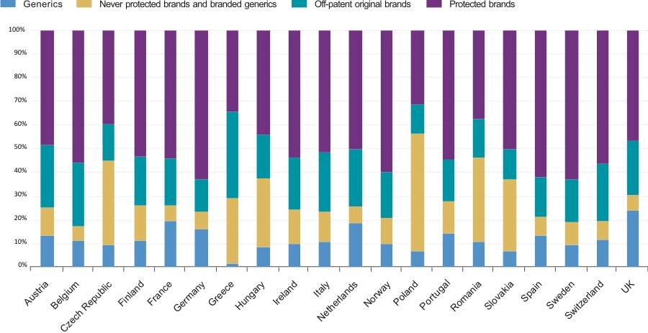
Still considerable opportunities to increase uptake throughout Europe
Protected and off-patent marked share (value) by country, June 2015
Source: IMS Health, MIDAS, Q2 2015, retail and hospital channel
Note: Non-original brands and branded generics include copy products in some countries; Generics include INN branded and company branded
Notes:
While the green bars in this graph show the opportunity to increase uptake of generic medicines today, while the purple bars show the current value spend on protected branded medicines which are an opportunity for generic medicines in the future.

